Slide 1


GAMETRACK
ERD
/FIREBASE
OUTLOOKS
THE CREW

Slide 2
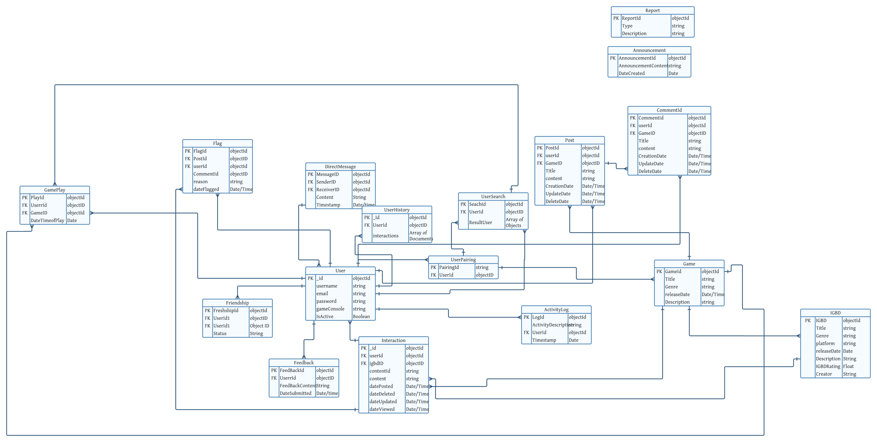
UPDATED ERD

Slide 3
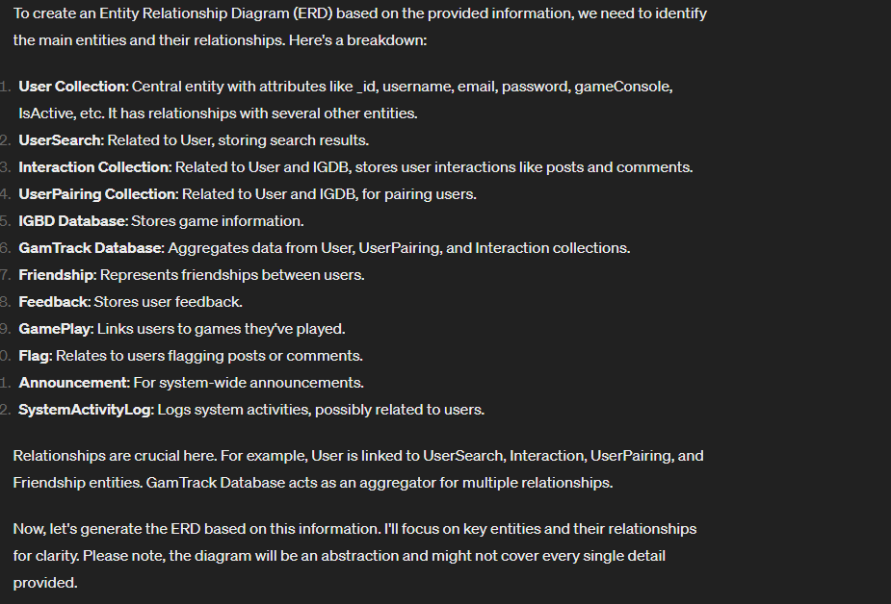
PROMPTS
1

Slide 4
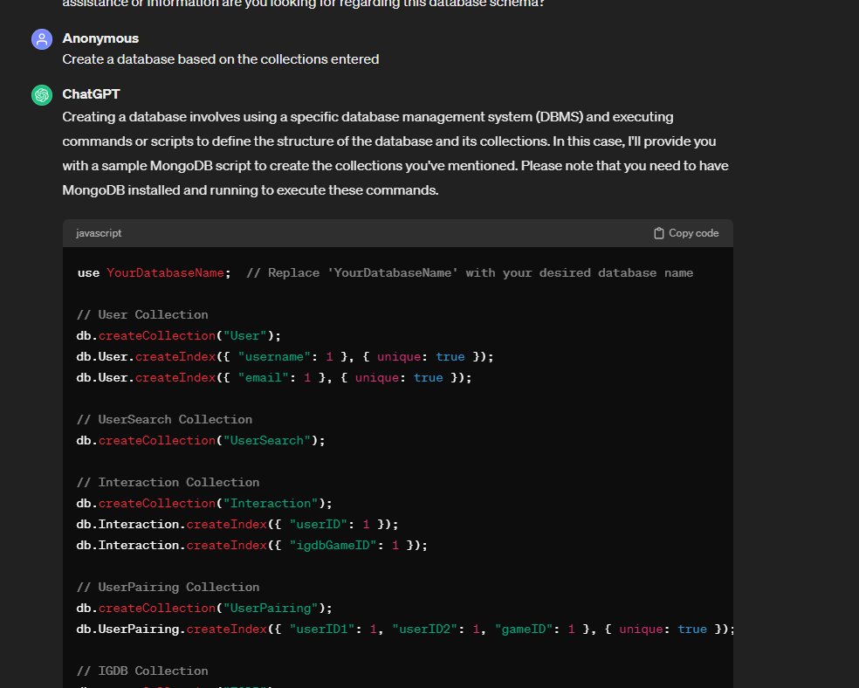
PROMPTS

Slide 5
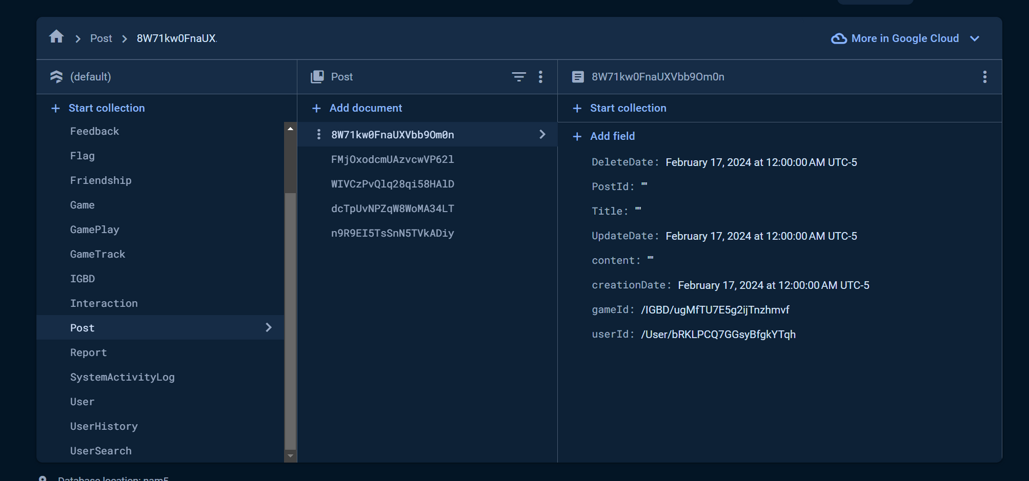
FIREBASE

Slide 6
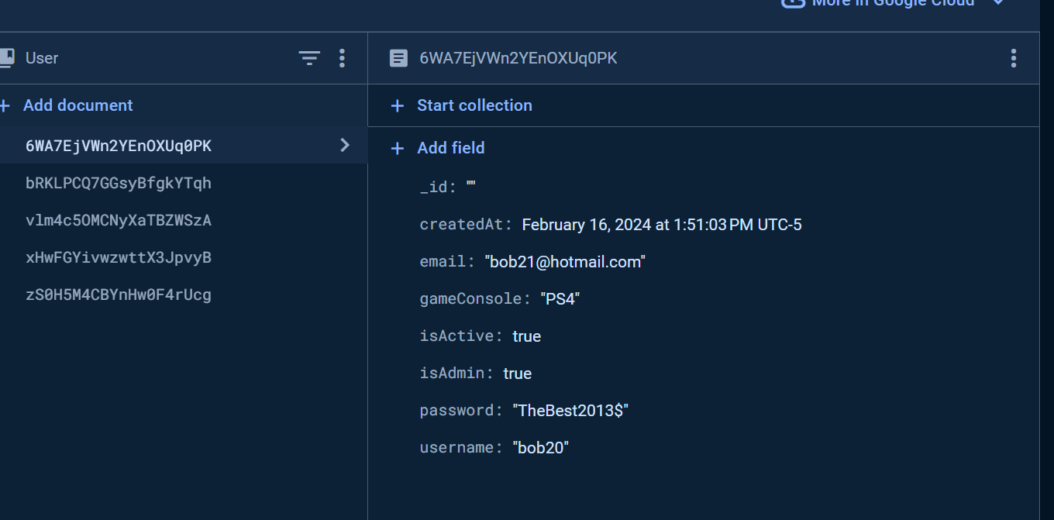
User Collection

Slide 7
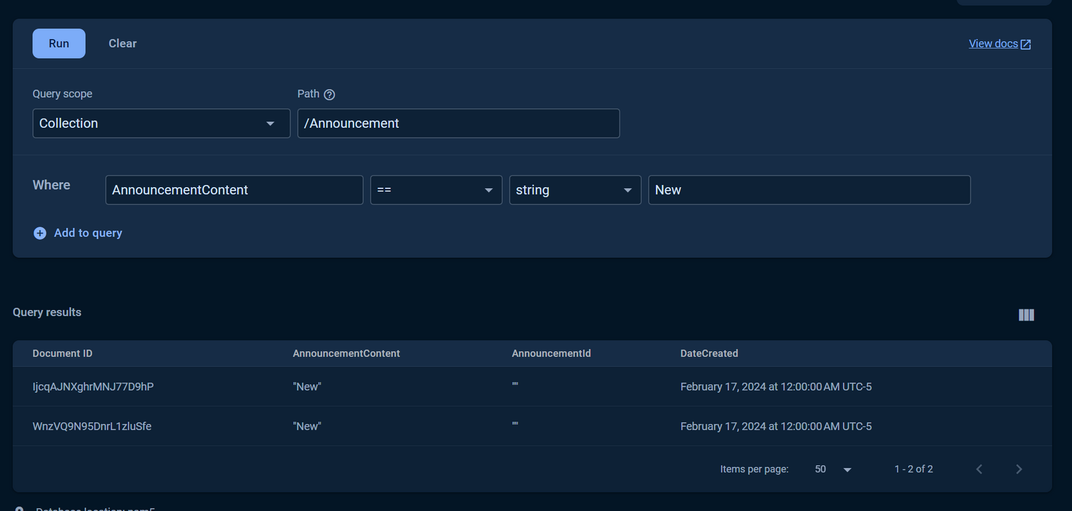
Queries

Slide 8
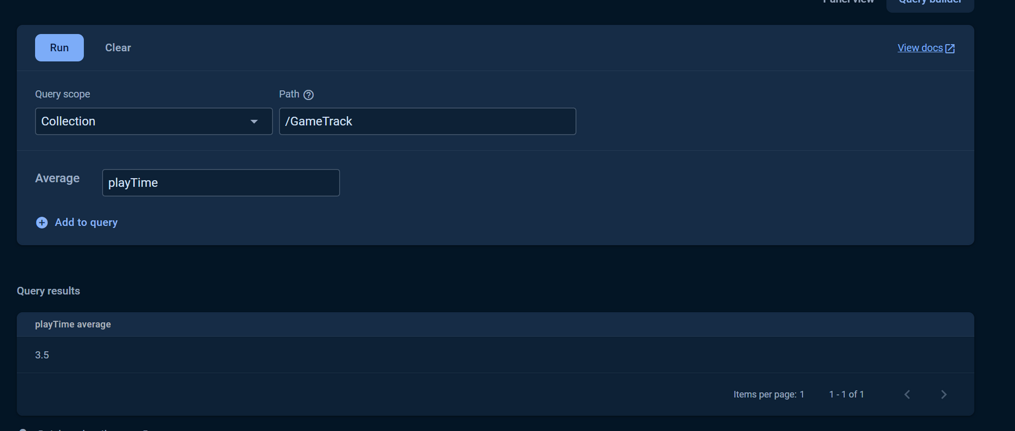
Queries

Slide 9
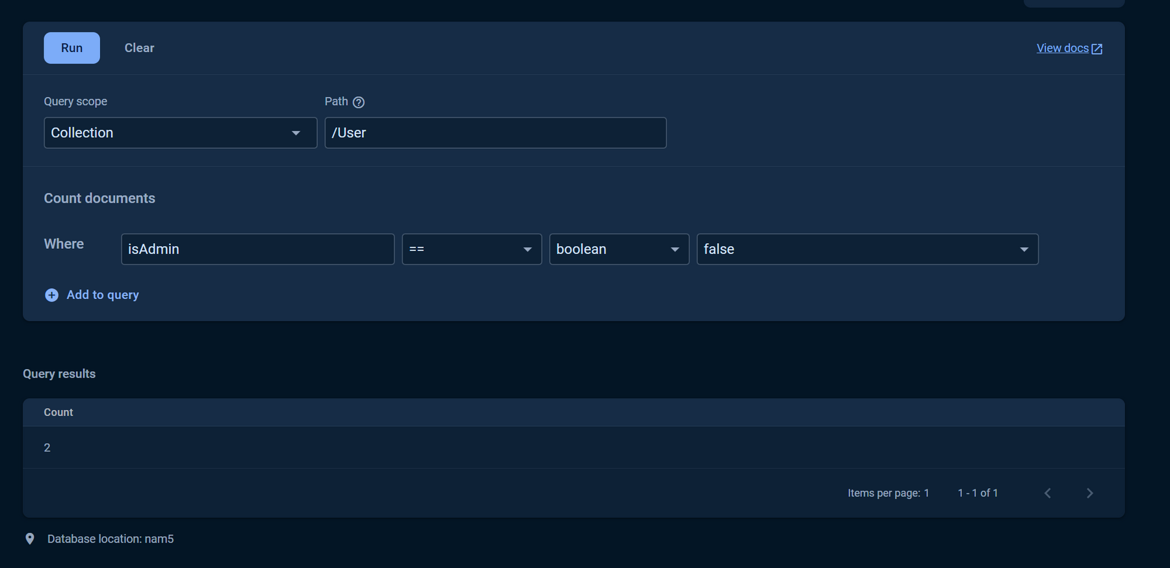
Queries

Slide 10
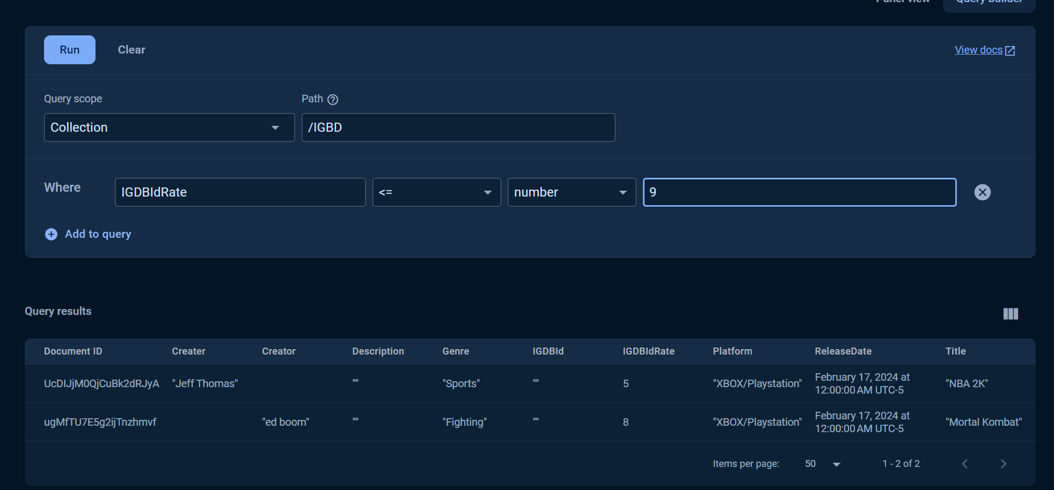
Queries

